Slide 1

Start-up@ india data analysis
Vikram Krishna N
INSAID Feb’2021 batch
Date: 09/06/2021

Slide 2

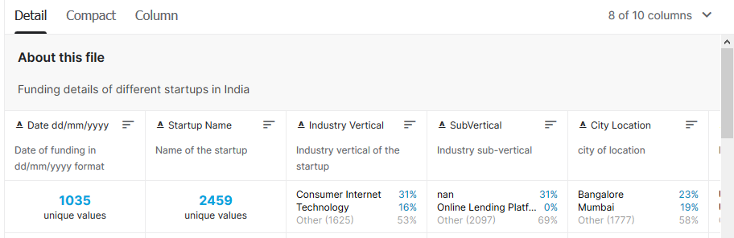
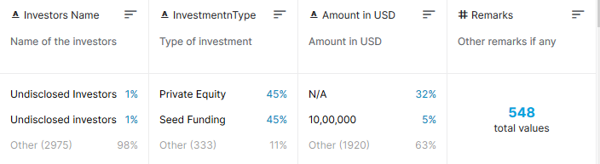
Introduction
Objective:
As a part of INSAID GCDAI course project submission:
Attempt to use the exploratory data analysis of Indian start-up funding and derive trends, which can hopefully help new incumbents to better understand the industry funding patterns to improve there chance of success.
Data source:
https://www.kaggle.com/sudalairajkumar/indian-startup-funding
Data overview:
On the left the general information on the available in the open source data and missing data information.
It mainly concentrates on Indian start-up data or investments in India, In total has 3044 rows of raw data between a period of 2015-2017

Slide 3

Data clean-up overview
The input file was quite raw, with many missing data points and improper classification, too many generic or inconsistent nomenclature in all categorical fields
Basic clean-up like, irrelevant columns sl.no, remarks were dropped; missing city locations replaced as ‘India Other’; missing industry vertical as ‘unclassified’; date formatted and amount formatted to float (without ‘,’), missing ‘Sub-vertical’ data replaced with industry vertical
Type of Investment was sorted with main intention to identify seriousness of the investment, hence ‘private angel’, ‘venture_capital’ as early investments , ‘pre-series A,B’ – indicating early industrialisation, Series C-H – indicating high degree of industrialisation, Debt and Others
City locations were sorted to Top 6 regions and Others, with main intention to classify as geographical related benefits, example: e.g., instead of Delhi, Gurgoan, Noida → NCR.
Industry vertical classification was found erroneous, too generic (like consumer internet, technology) and raw unclassified data in these fields, while Sub-vertical had more useful information on description of the start-up, so I decided to go the hard way to use the ‘Sub-vertical’ data to re-classify the content.

Slide 4

Data clean-up overview
The approach used for Industry classification was ‘Word count frequency’ find the ‘keywords’, check if this ‘keyword’ was a good representative of the industry vertical and if yes, then ‘industry vertical’ content was replaced with the keyword.
This was iteratively done at first in ‘industry verticals’ as much as possible like fintech, meditech, edtech, and finally using horizontal areas like software_cloud_services, AI_Data_analytics, etc. This step involved lot of manual labour in sorting via keywords.
The target was to classify >80% of the content, after using the above process, the left over ‘unclassified data’ was replaced with original ‘industry classification’ where available and matching the new keywords
Since large clean was done, the output file was saved as ‘Startup_information_cleaned.xlsx’
Further Data analytics was done with this file as the input for Start-up funding analysis

Slide 5
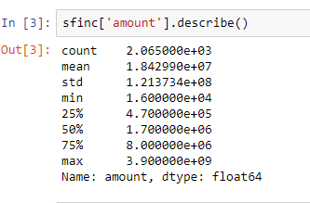
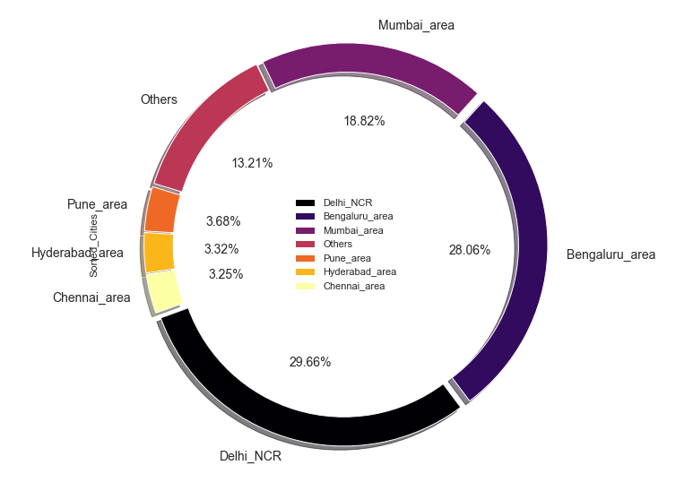
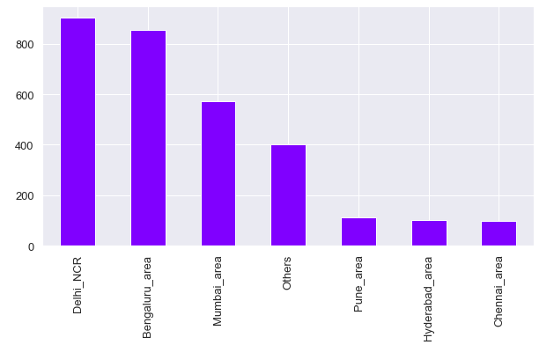
Analysis findings (1/6)
Funding was clearly ‘right shifted’, nearly by a factor 10, clearly indicating there were lot of ‘outliers’ in the data set they were taking most of the funding
NCR (~30%) and Bengaluru (~28%) area have the most number of investments done during this period

Slide 6
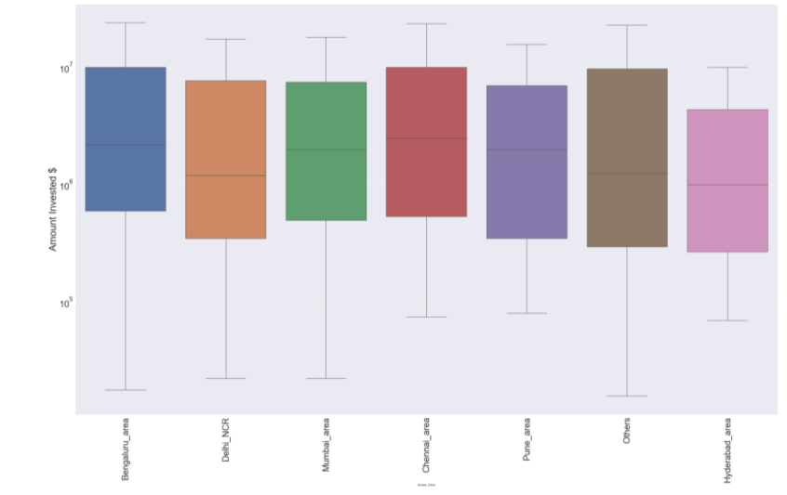
Analysis findings (2/6)
Even though the number of funding was found largely different be cities, the median funding was found relatively much closer
Top3 are Chennai, followed by Bengaluru and Mumbai.
NCR being highest in-terms of no. of investments actually lacks in both median and 75% invested amount

Slide 7
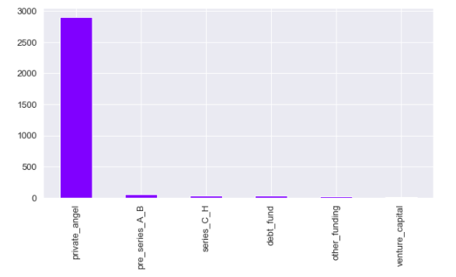
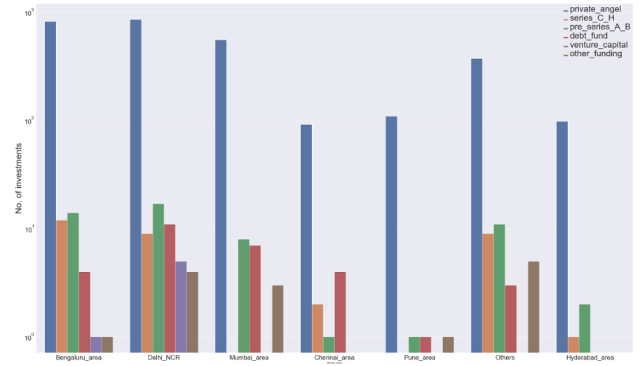
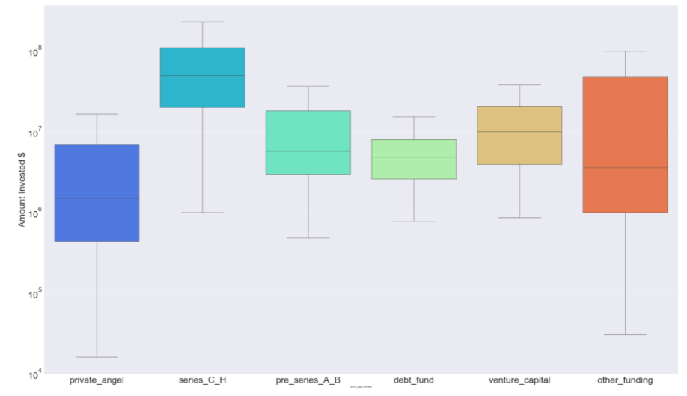
Analysis findings (3/6)
Bengaluru and NCR area have the most number of pre-series and series investments done, while other regions still seem to be in early stages in industrialisation
While no. of private and angel investor was the highest number of investments, the series investment (C-H) clearly highest value of investment, followed by venture capital investment and then followed by pre-series A,B investments

Slide 8
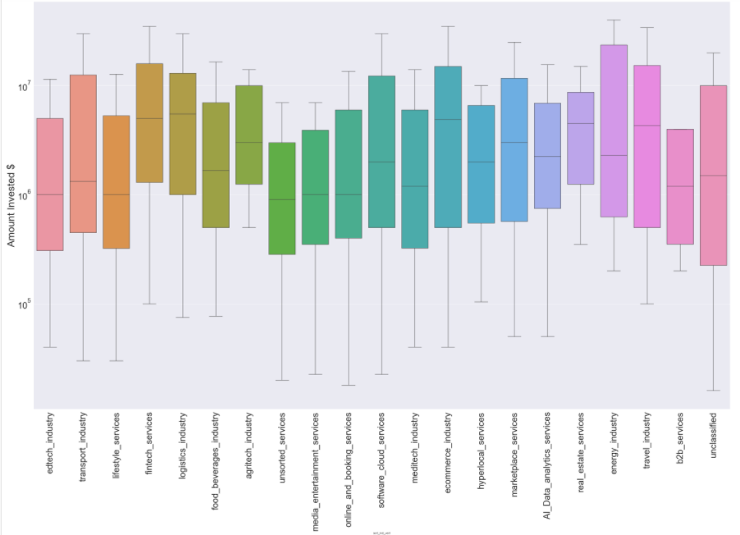
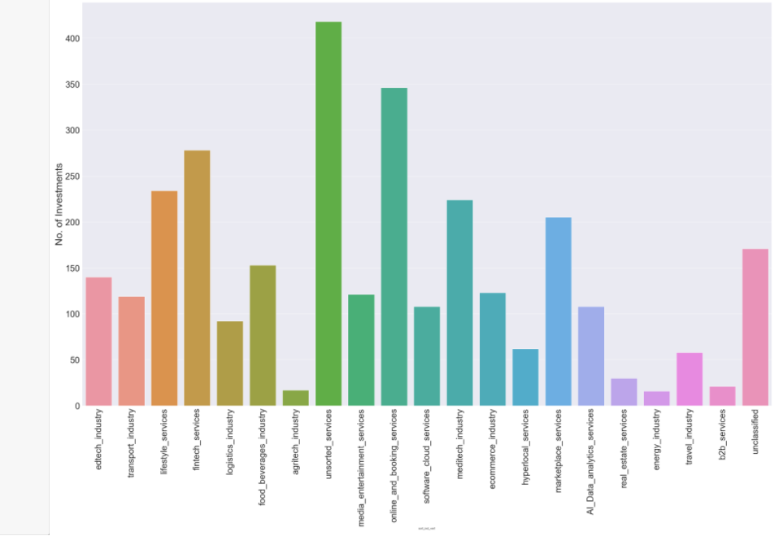
Analysis findings (4/6)
2
1
3
4
5
Top 5 performers as industries:
Logistics
Fintech
e-commerce
Real-estate
Travel industry
1
2
3
5
4

Slide 9
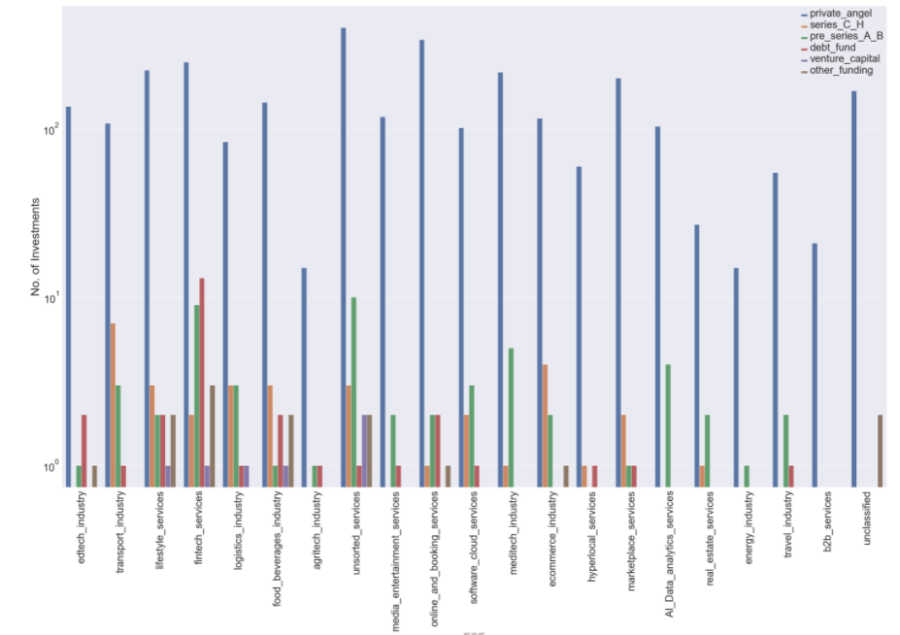
Analysis findings (5/6)
Most series investment, industry type:
Transport
e-commerce
Fintech
Logistics
Lifestyle

Slide 10
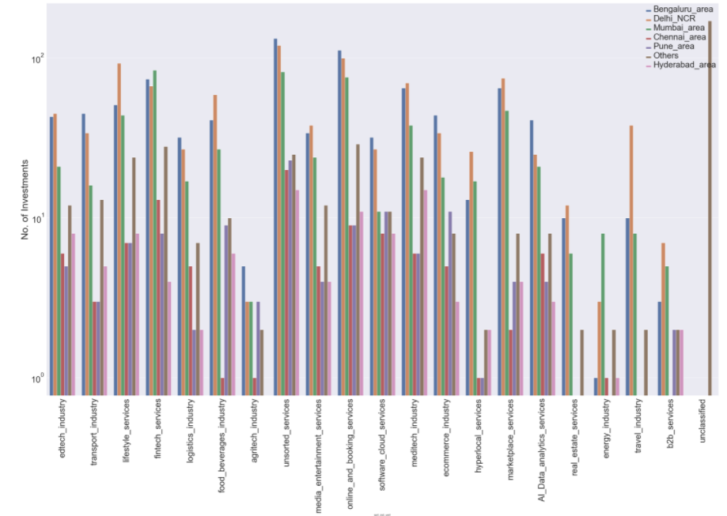
Analysis findings (6/6)
Regions and top Investment interest:
Bangalore:
Transport, logistics, Online, SW, ecommerce, AI-Data-analytics, agritech
NCR:
Edtech, Lifestyle, food_beverages, media, meditech, hyperlocal, market place services, travel and b2b services
Mumbai:
Fintech, energy industry

Slide 11
Summary of analysis*
NCR, Bangalore and Mumbai are the most popular destinations for start-up investment opportunities in India
By median amount of investments: Chennai, Bangalore and Mumbai are top performers (could be an indicator of more valuable start-ups by region)
While as expected series investments largely outperform any form of investment, venture capitalistic investment could be interesting proposition for a new start-up for funding source.
Top 5 industry verticals during this period (pre-covid) by value: logistics, fintech, ecommerce, real-estate and travel industry
Top 5 industry verticals during this period (pre-covid) by series investments: Transport, fintech, ecommerce, logistics, lifestyle.
Bangalore leveraging on its transport and SW industry, while NCR is largely leveraging on lifestyle centric and Mumbai on finance & energy strength
* Analysis considered only pre-liminary for trend indication, strictly for non-reliance

Slide 12

Thankyou

